Slide 1


Pricing components with toggle

Slide 2
project
Pricing components with toggles :
View the optimal layout for the component depending on their device's screen size
Control the toggle with both their mouse/trackpad and their keyboard

Slide 3
Pricing
Pricing is a process of fixing the value that a manufacturer will receive in the exchange of services and goods. Pricing method is exercised to adjust the cost of the producer’s offerings suitable to both the manufacturer and the customer. The pricing depends on the company’s average prices, and the buyer’s perceived value of an item, as compared to the perceived value of competitors product.

Slide 4
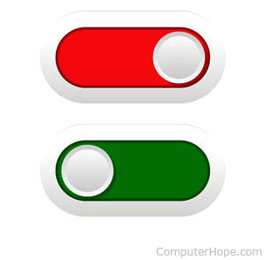
Toggle
A toggle switch is one that has only two positions. For example, light switches that turn a light on or off are technically considered toggle switches. On computer keyboards, the Caps Lock Key is a toggle switch that controls the input case of the keys being pressed.

Slide 5
TOGGLE IN SOFTWARE
In a range of software applications, a toggle is usually found in the form of a checkbox. Some of examples of a software toggle include:
Selecting parameters to filter a list of items or results.
Tapping and holding a touchscreen to switch between an edited and unedited view of a photograph in a photo editing software.
Using keyboard commands to enable bold font formatting in a word processing application.

Slide 6
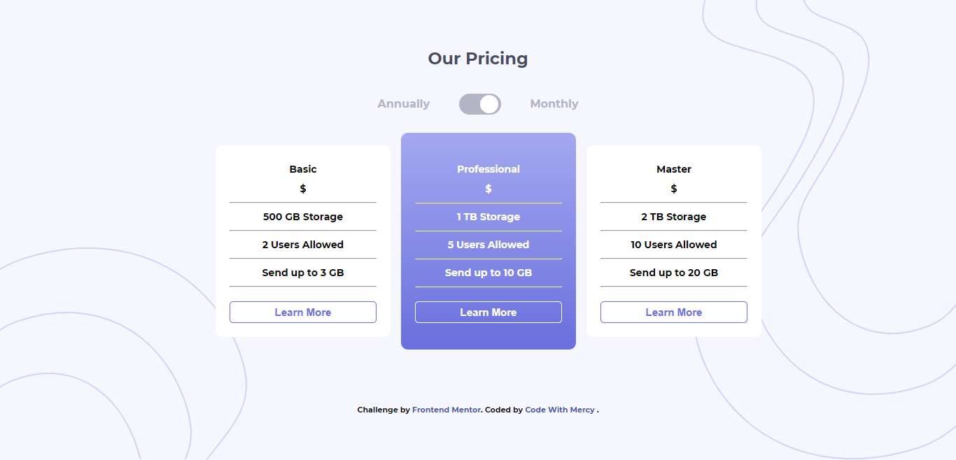

Slide 7
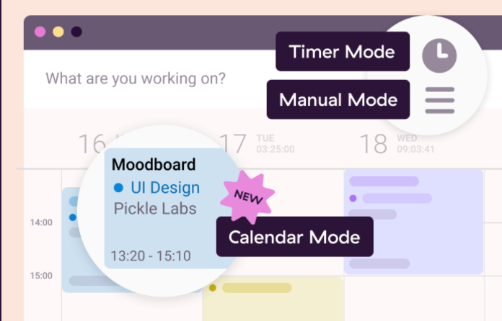
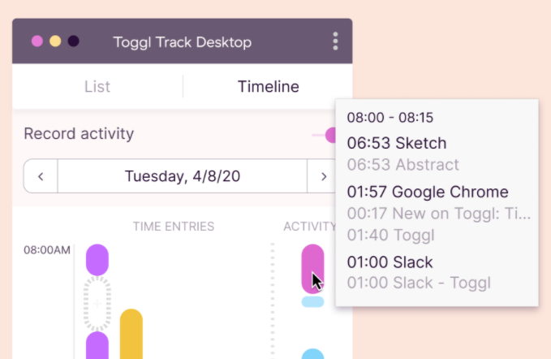
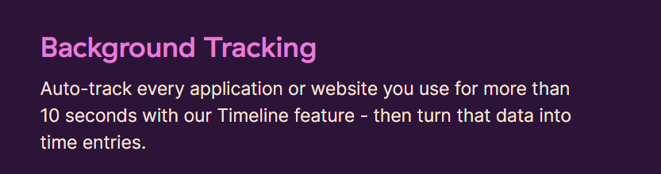
Features : Time Tracking

Slide 8
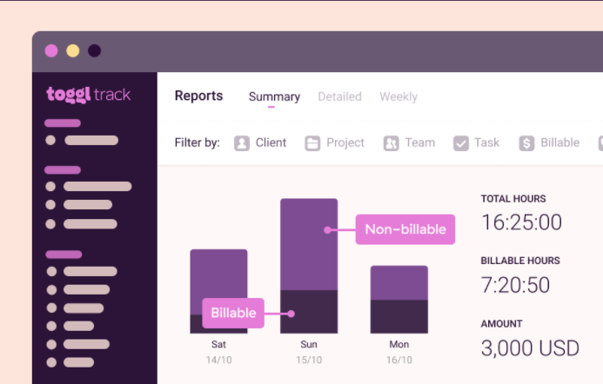
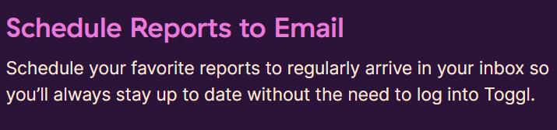
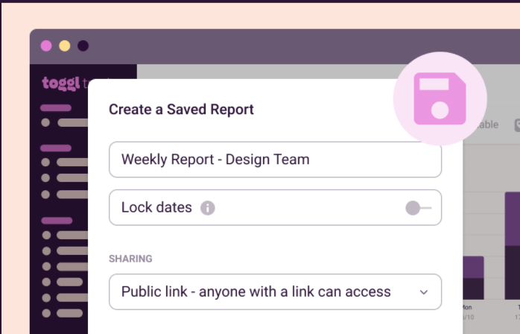
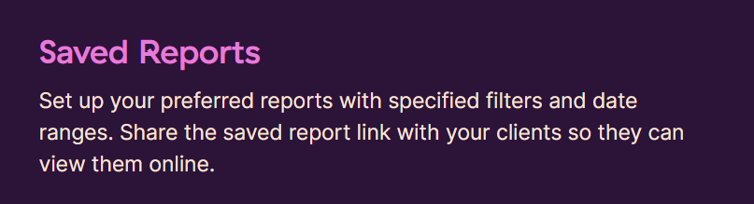
Reporting

Slide 9
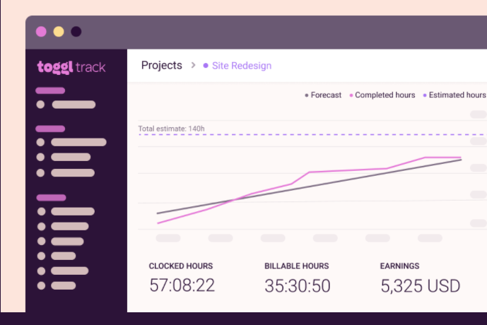
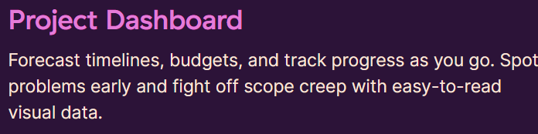
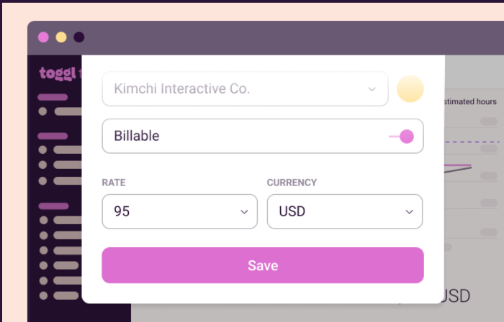
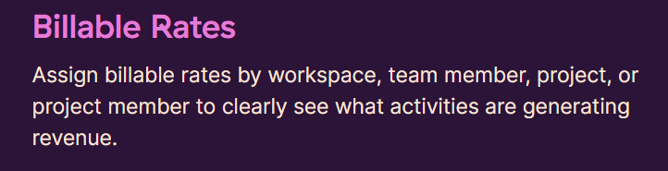
Project & Revenue Tracking

Slide 10
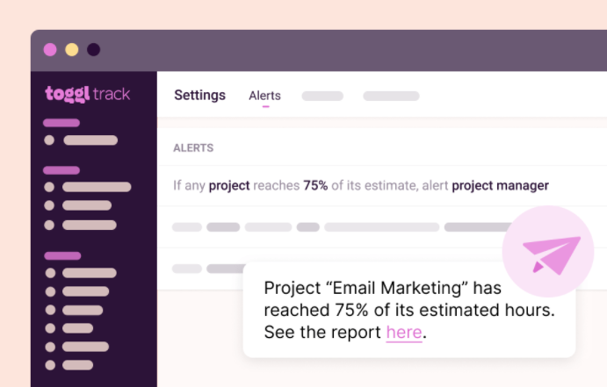
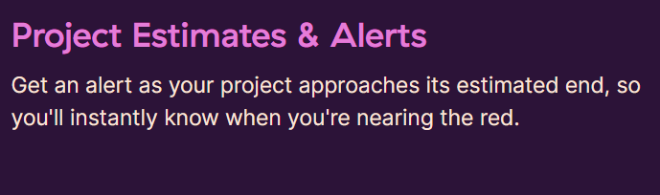
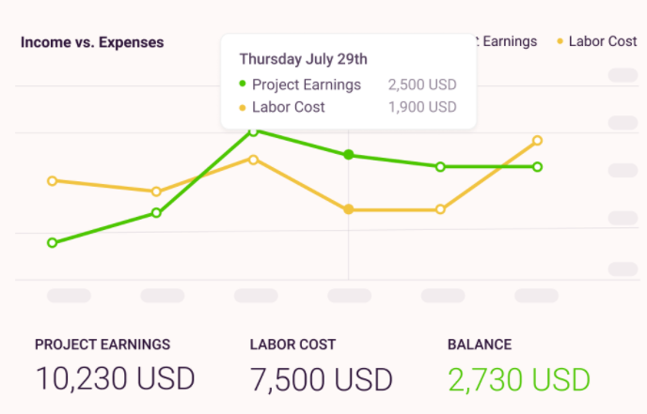
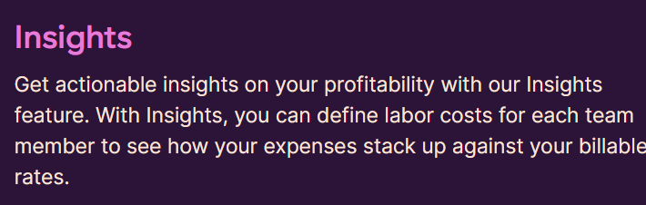

Slide 11
CONCLUSION
Annual and Month to be clicked as well as the toggle itself. the labels of radio button inputs and the radio button inputs themselves visually hidden. Radio button inputs have accessibility built-in to them.
The toggle is clickable and has a hover state, To hide the frequency reader as they will be able to change the payment frequency using the radio buttons. The toggle is also not accessible via the keyboard for the same reason.

Slide 12
THANK YOU

